Slide 1
Working with files

Slide 2
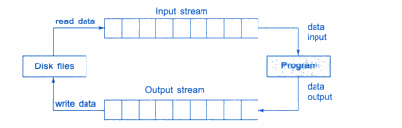
Introduction

Slide 3
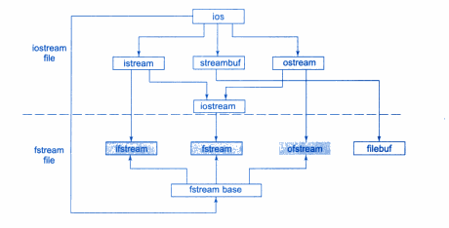
Classes for file stream operation

Slide 4
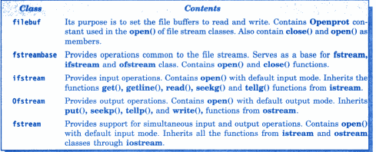
Opening and closing file

Slide 5

Opening file using constructor

Slide 6

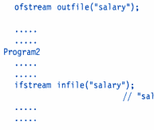

Slide 7
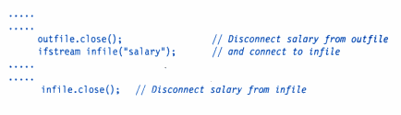

Slide 8
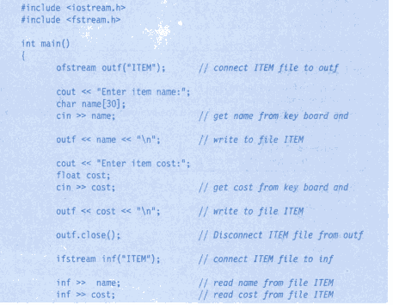

Slide 9
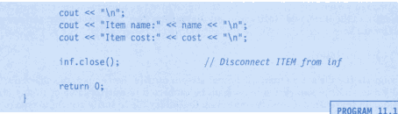


Slide 10
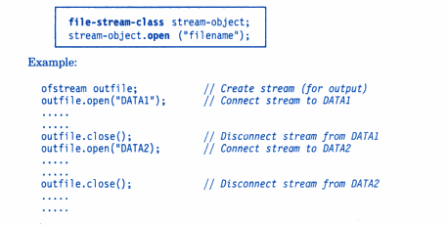
Opening file using open()

Slide 11
Detecting EOF
While(fin): returns a value 0 if any error occurs in the file operation including end of file condition.
If(fin1.eof()!=0)
{ exit(1);}
eof() is a member function of ios class. It returns a non-zero value if the end of file condition is encountered and zero otherwise.

Slide 12
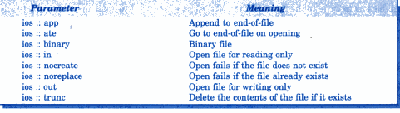
File Modes

Slide 13
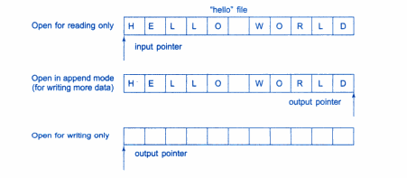
File Pointers

Slide 14

Manipulator functions

Slide 15


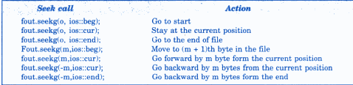
Specifying the offset

